Slide 1
Impulse Control
Key to Training Success!
Presented by Sandi Pensinger & Monica Pielage

Slide 2
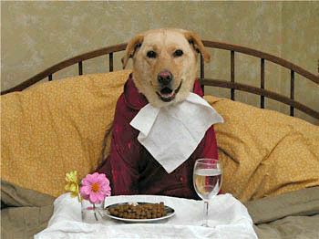
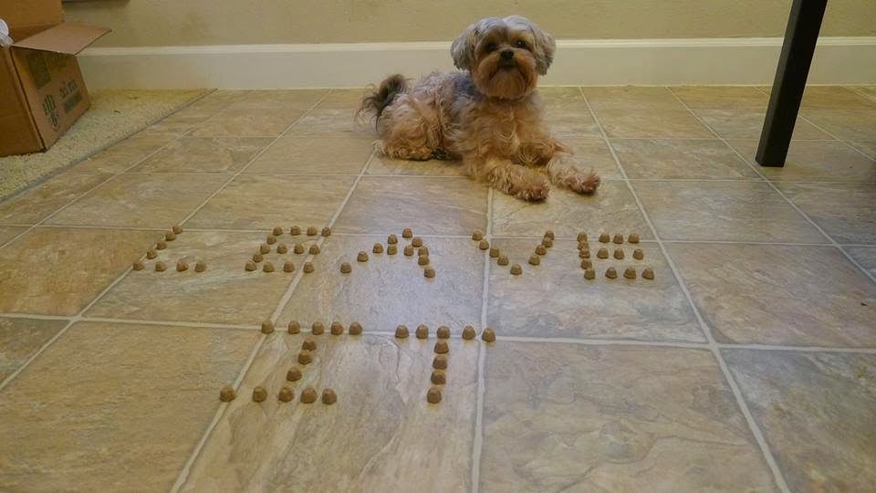
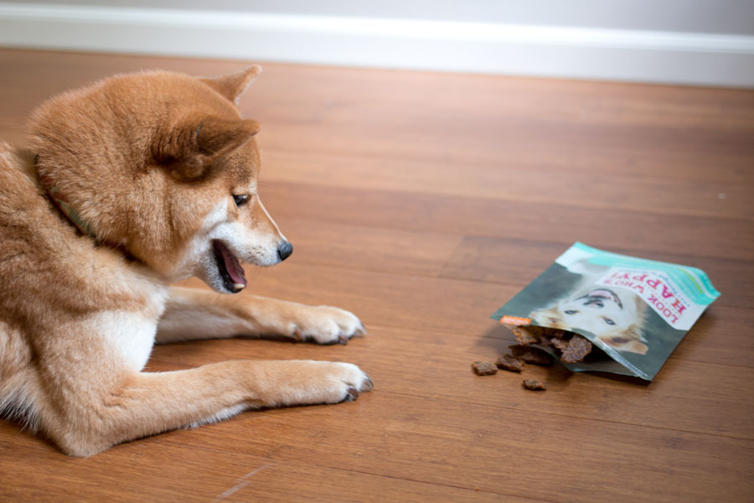
Impulse Control Overview
What Is Impulsive Behavior?
The Many Facets of Impulse Control
How You Can Train Your Dog

Slide 3
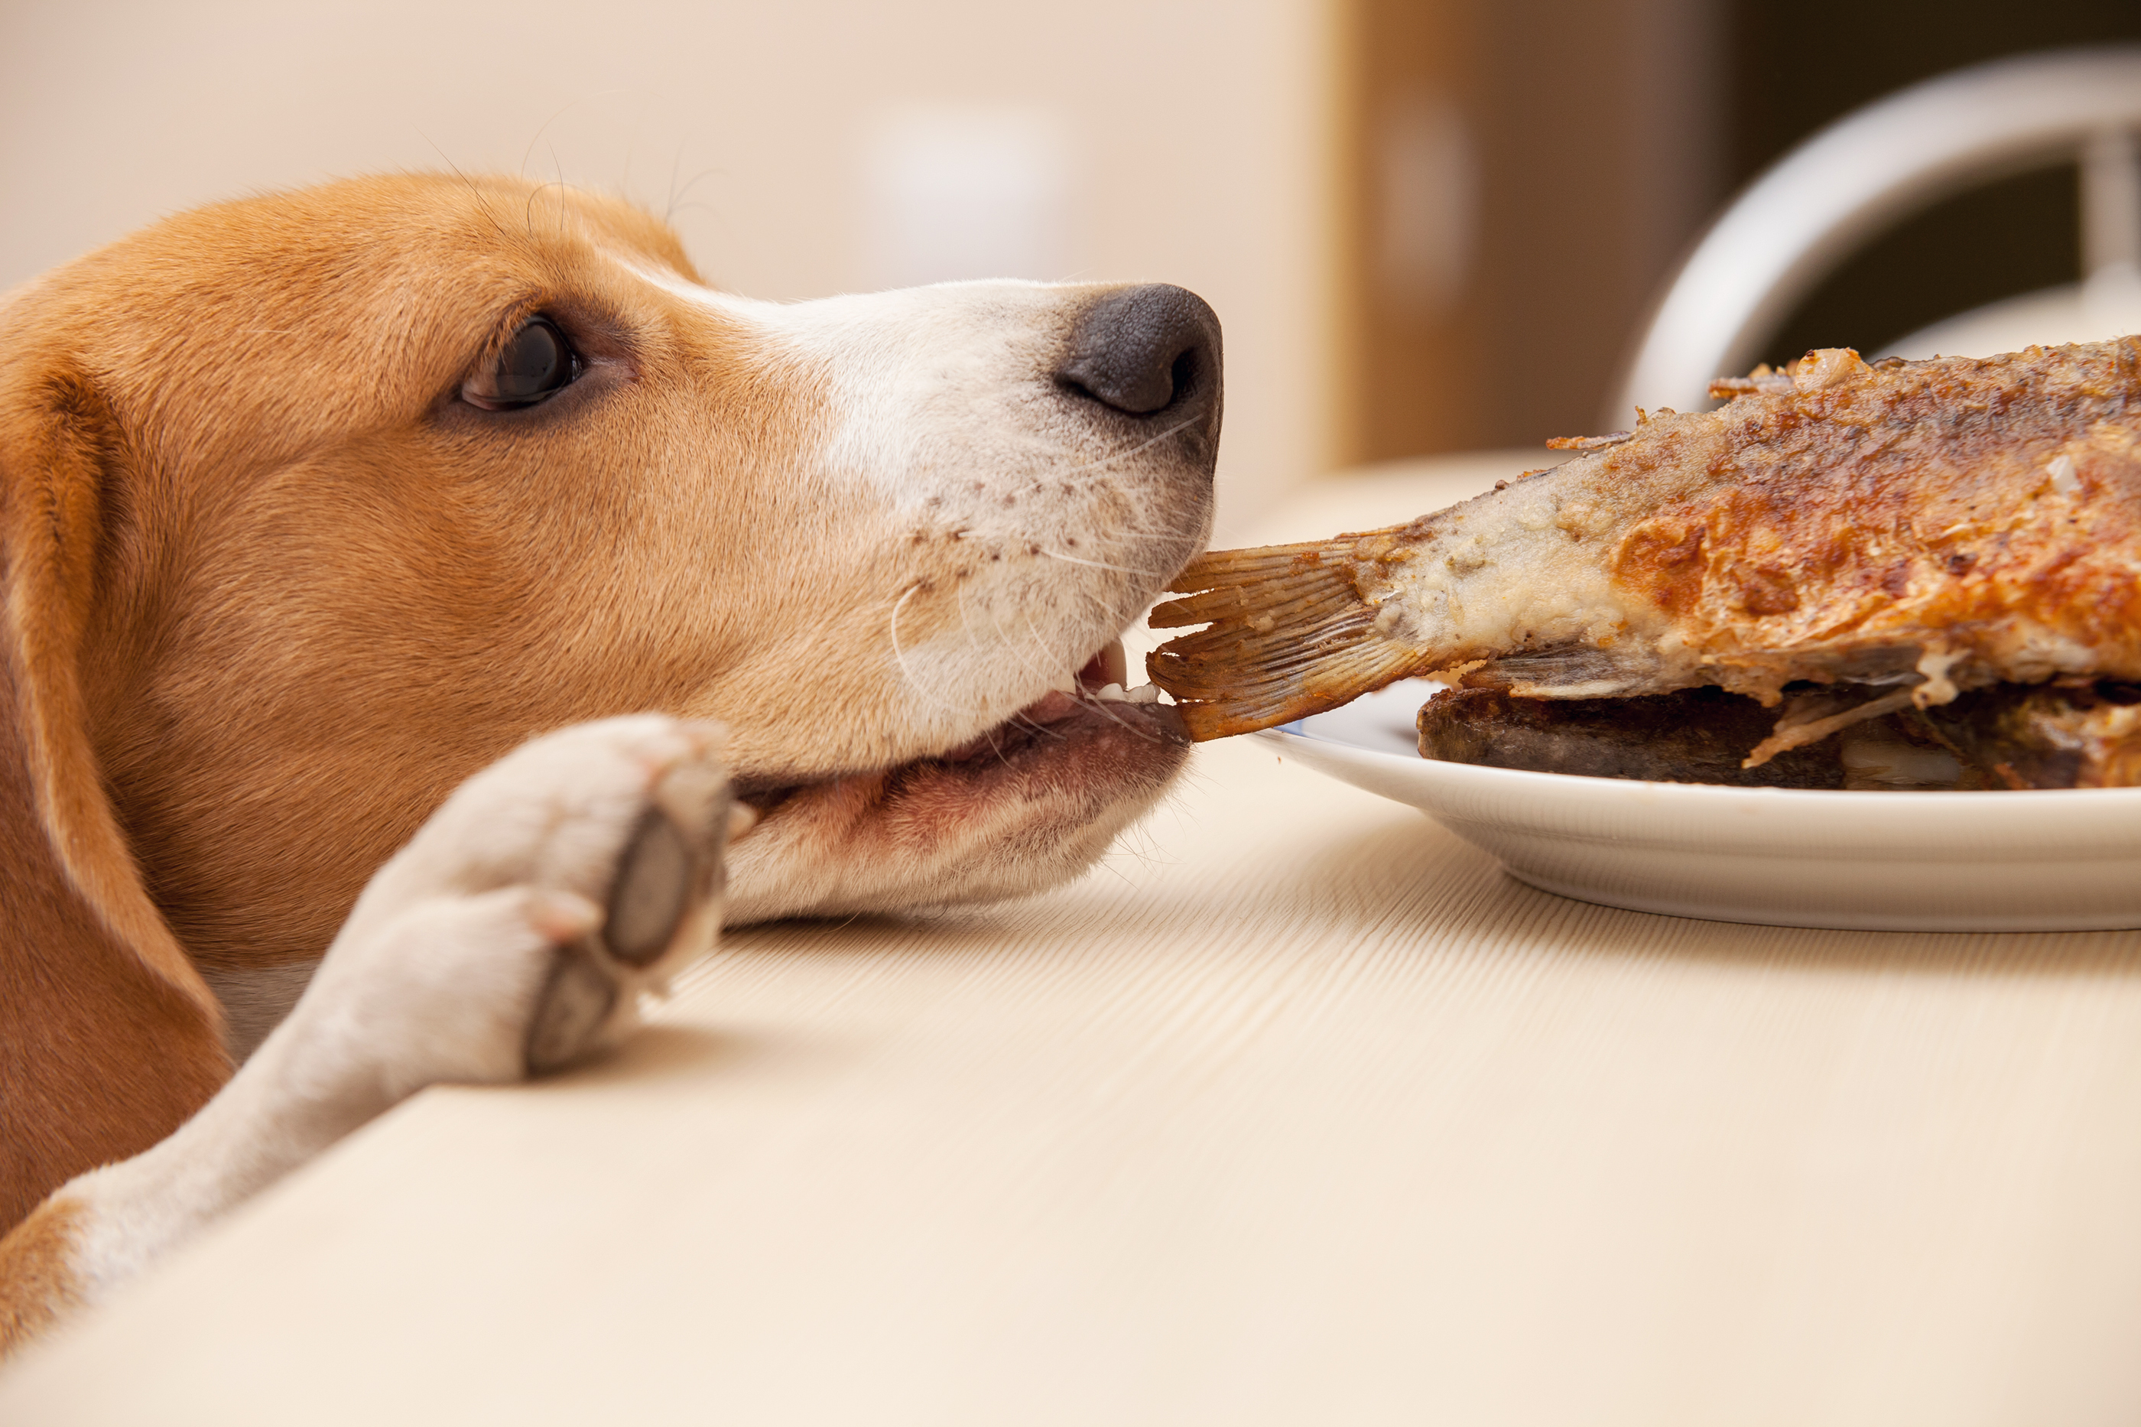
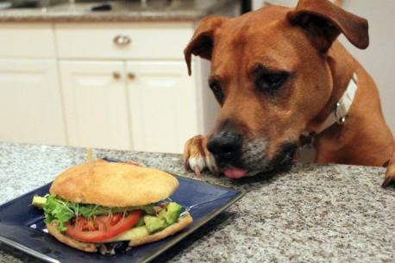
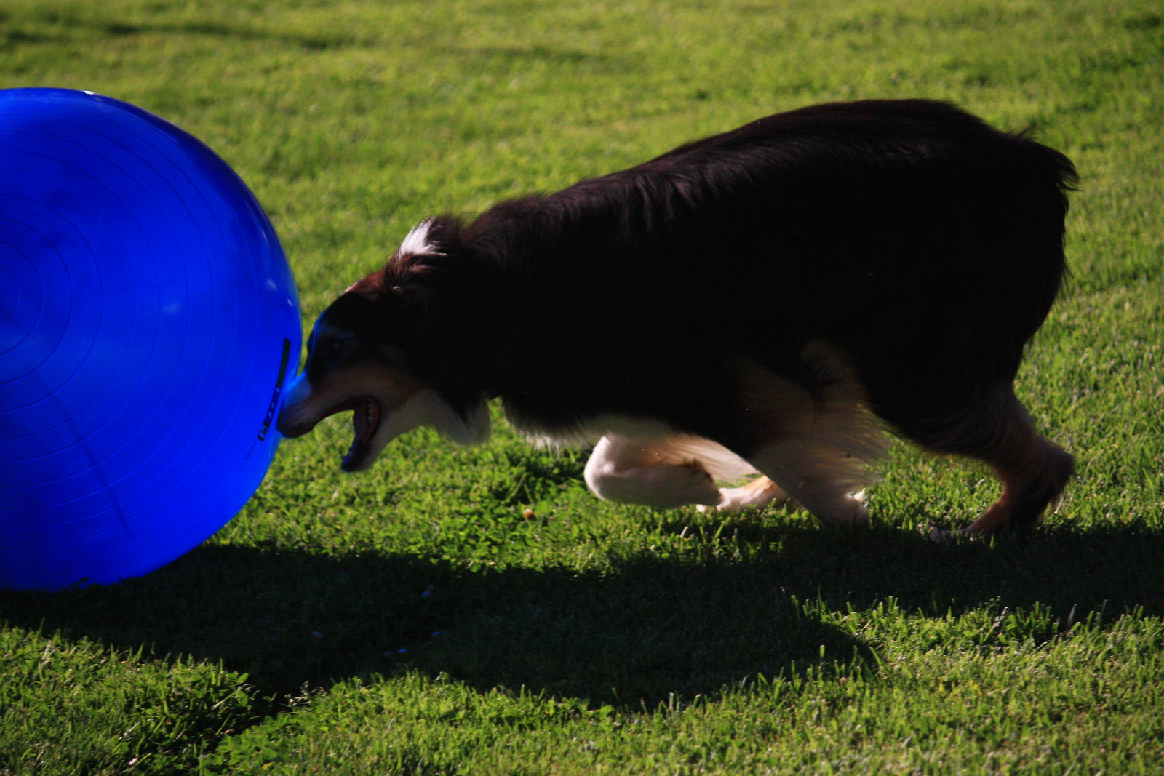
What is Impulsive Behavior?
The inability to inhibit behavior in the presence of salient cues.
I want it ALL and I want it NOW!

Slide 4
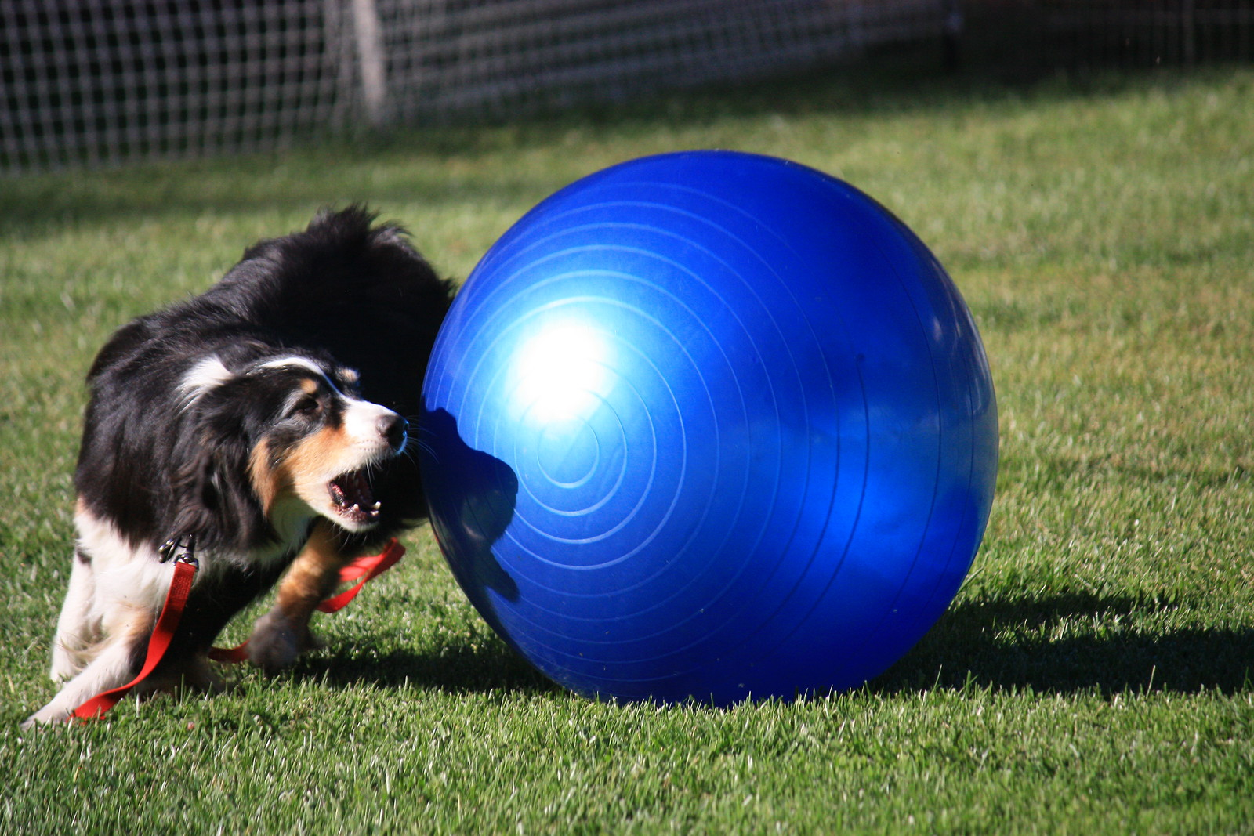
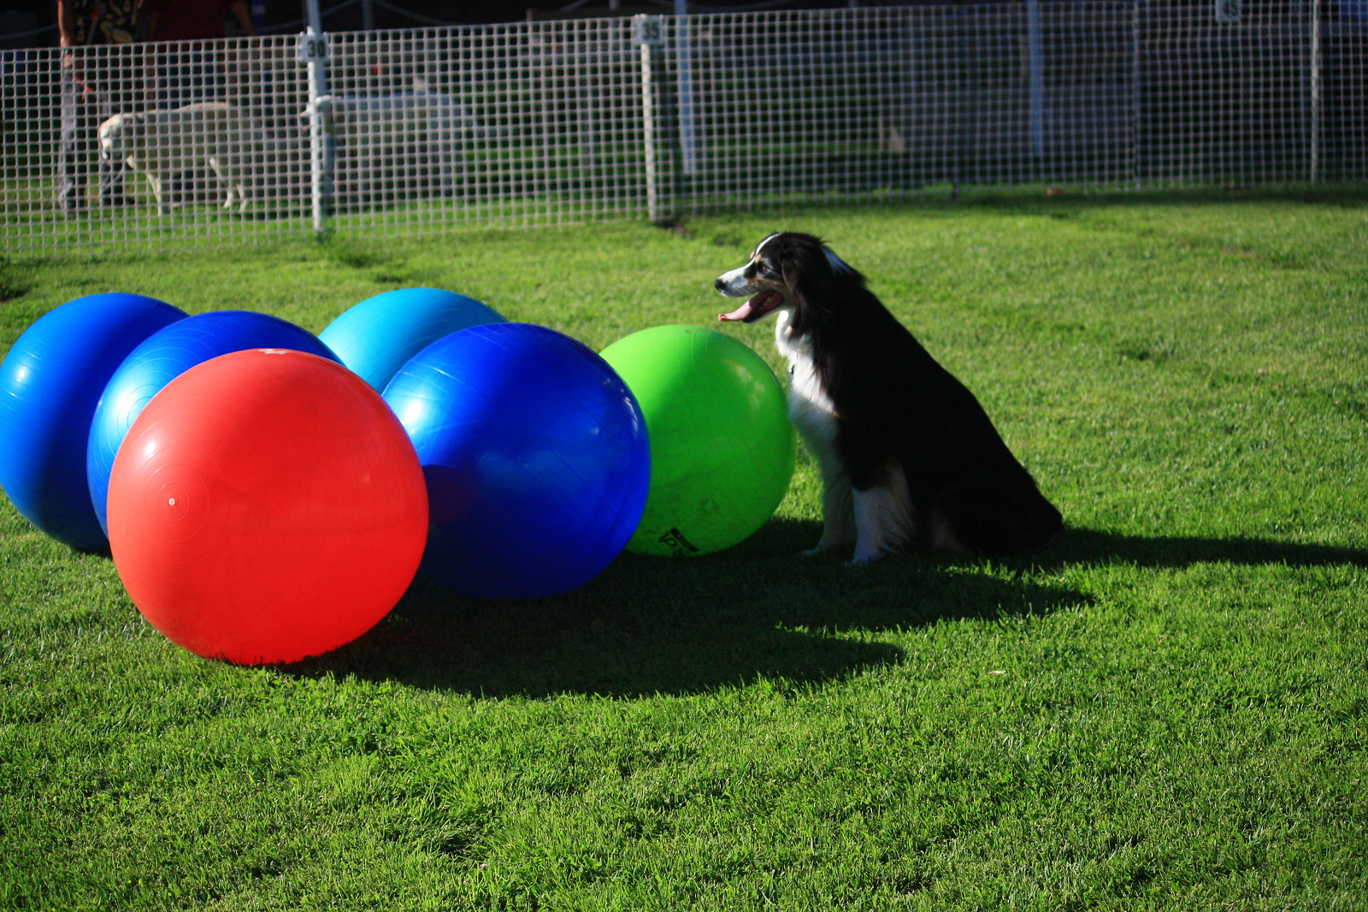
What is Impulse Control?
Impulse control is SELF control
It comes from within the dog, eventually

Slide 5
What is Imposed Control?
You impose your will on the dog
The dog has no freedom to choose (Tight leash, push butt down for sit)
Management/Supervision
Time Outs, crate time, fences, baby gates, etc.
Corrections
Verbal Corrections (avoid – hurts relationship)
Eh-Eh!, Aaack!, Pssst!
Physical Corrections (not recommended)
Leash Jerks, Collar Jerks, Restraint, Pushing, Pulling, etc.
Spray bottles, penny cans, etc.
Or worse

Slide 6
Impulse Control has many facets
Physical
Nutrition
Psychological
Management
Training
Handler Skills
Generally considered about Over Arousal not so much Under Arousal
There is no Easy Button
Many Facets

Slide 7
Optimal performance is reached at intermediate levels of arousal
Optimal Arousal
Optimal Performance
Strong
Increasing Attention
and Interest
Performance
Arousal too high. Aroused by everything
Arousal too low.
Distracted by irrelevant things
Weak
Low
High
State of Arousal

Slide 8
Arousal Continuum
LOW AROUSAL
MASTIFF
BEAGLE
GERMAN
SHORTHAIRED
POINTER
JACK RUSSELL
TERRIER
HIGH AROUSAL
THEORY - NOT proven fact – but interesting, useful concept
In general, dog breeds/individuals have a set place on the continuum of arousal.
The theory is that you cannot take a Jack Russell and train them to be lower arousal than their lowest point or higher than their highest point on the continuum.
Are you willing to accept this? Do you have anecdotal experience to the contrary? Where’s the proof?

Slide 9
Physiology: Hormones Play A Key Role in Impulsivity
Adrenalin
Excitatory – Fight or Flight Response
Dopamine
Excitatory – Role in Reward Motivated Behavior, Habits & Addiction
Seratonin
Calming – Mood, Digestion, Sleep
Cortisol
Enhances the brain’s use of glucose (energy) & regulates metabolism

Slide 10
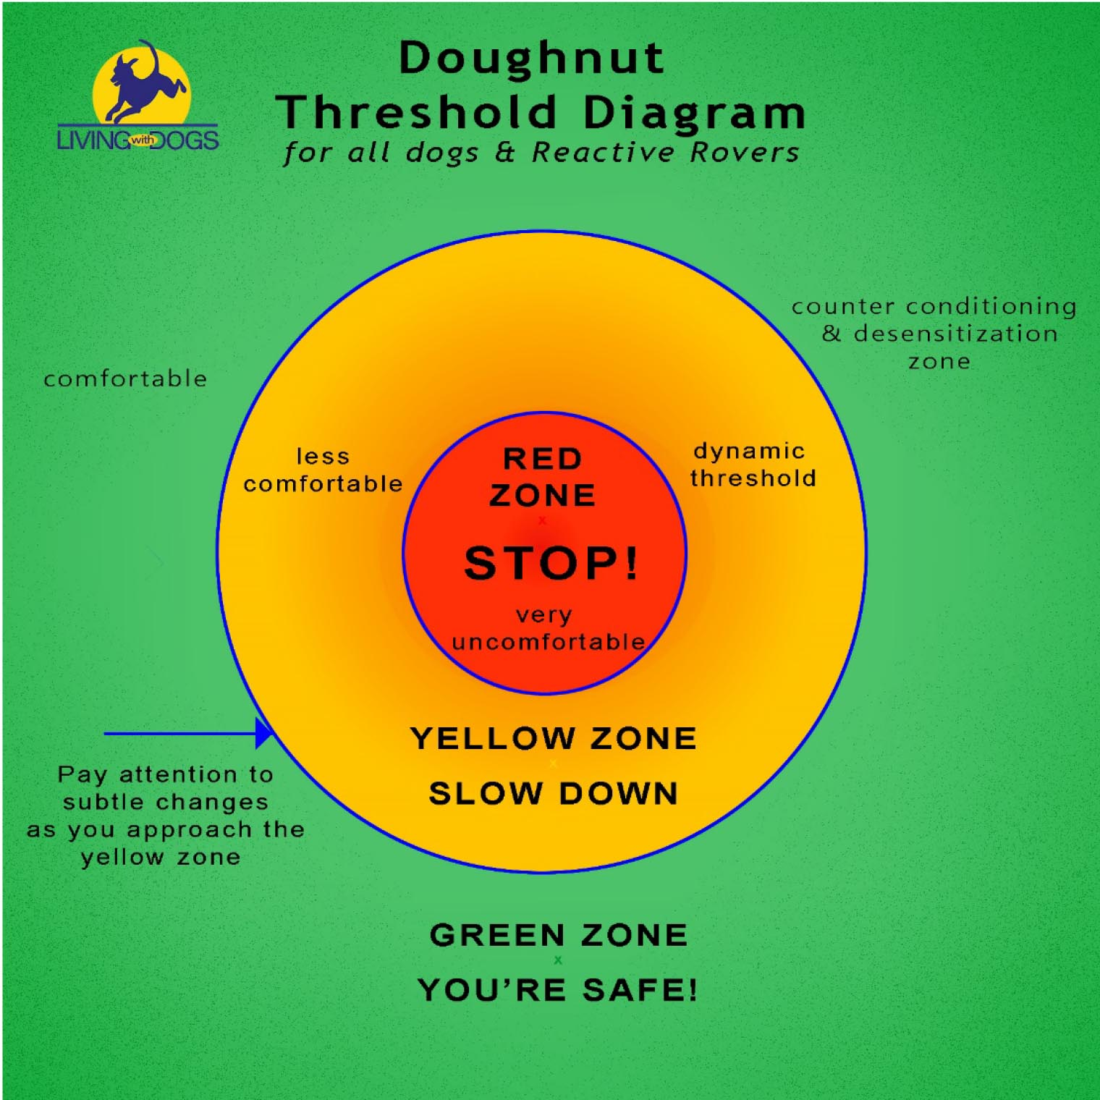
Thresholds
Threshold is the distance at which an animal reacts negatively toward a stimulus
How do they impact the sport dog?
Decreased performance

Slide 11
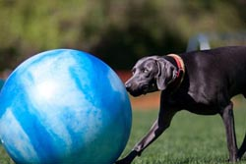
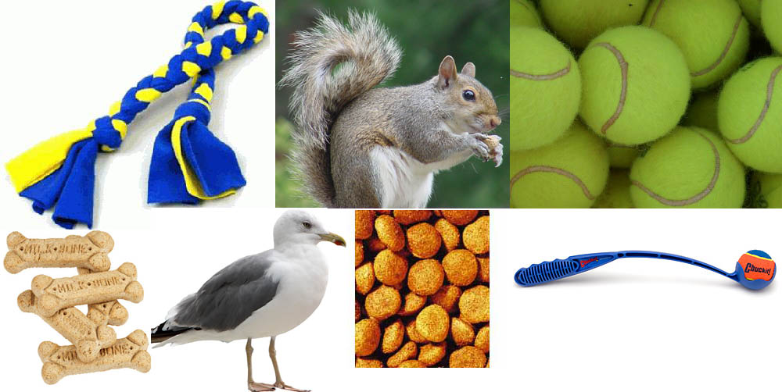
Triggers for Impulsive Behavior
Triggers for Treibball
The Ball(s)
Training area
Food
Toys
Rewards
Other/New Dogs
People
Motion
Distance from Handler
Freedom

Slide 12
How Can My Dog Learn Impulse Control?
It’s More Than Training
Reduce effect of triggers
Check Nutrition
Physical Exercise
Body Awareness
Rest, Sleep, Days Off
Mental Stimulation
Avoid Corrections & Stress

Slide 13
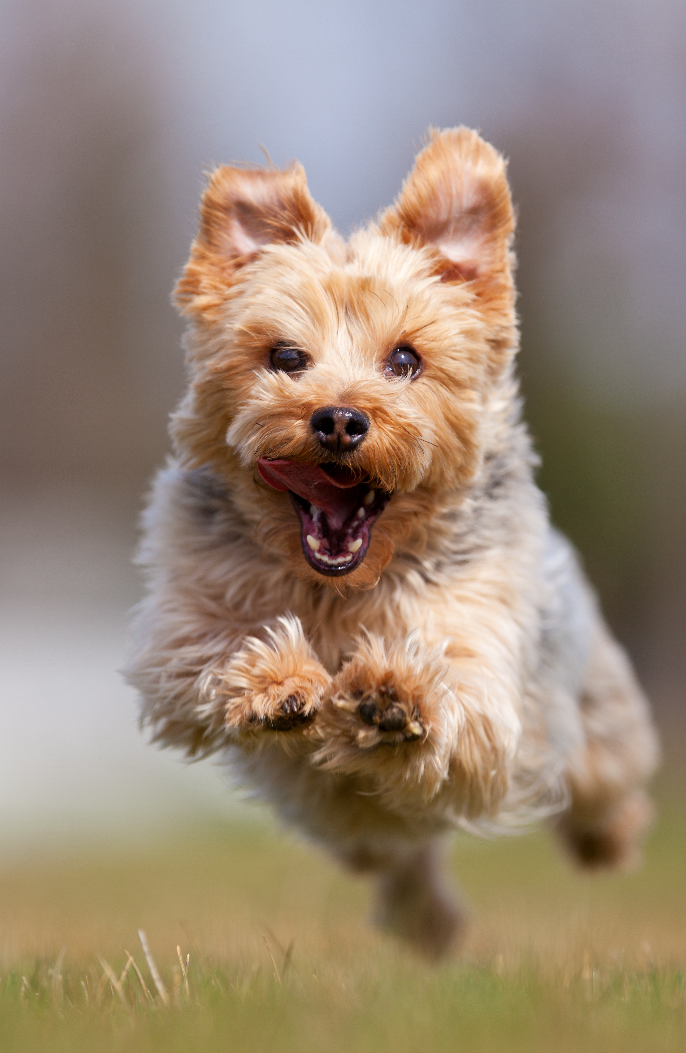
Bottom Line
Reduce number of times dog practices over aroused behavior
Increase number of times dog practices calm behavior

Slide 14
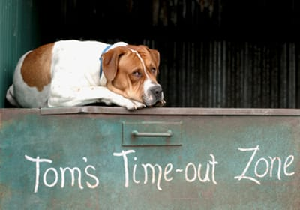
Interrupt Unwanted Behavior
If the dog continues to practice unwanted behavior, he will get better at it
Stop the game
Time outs after errors
Errors: Pushing before being cued, pick the ball up for a bit
Switch to obedience training – sit, down, stay
Recall the dog to you and start again
Crate them for a time out
Go for a walk

Slide 15
Avoid Stress
Short training sessions are best
Give days off from training
Change your routine occasionally
Go for long walks
Do things your dog likes to do
Take care of their basic needs
Let your dog take naps
Speak softly
If you have multiple dogs, give each dog quality time

Slide 16
Actions/Lifestyle
Managing & Supervision to prevent occurrence of undesired behavior
Daily Training
Animals learn whenever they have their eyes open
Low environmental distraction during training
HIGH ratio of reinforcement
Quick succession of repetitions
Increase training session duration slowly over time
Consistent cues
Interject self-control sessions with physical activity & play
PLAY! PLAY! PLAY! It’s got to be fun!

Slide 17
Using Play & Action As Rewards
Play is in the Eye of the Beholder (Your Dog)
Reinforce with Tug, Running, Fetch, Games, Go For a Walk, Sniffing, Hide & Seek
Relieves Stress
Movement is a Motivator
Movement Focuses Dogs on You
Builds Relationship
Variety Can Reduce Boredom, Frustration & Anxiety

Slide 18
Body Awareness
Helps with Ability to Focus
Body Awareness Exercises
Massage/Stroking
Exercise
Reduces Anxiety
Increases Performance

Slide 19
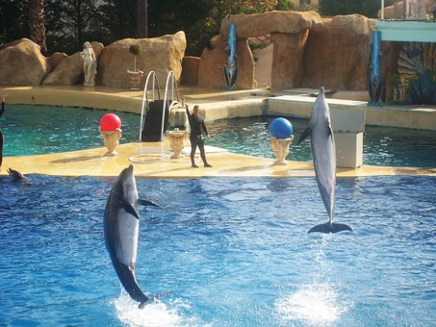
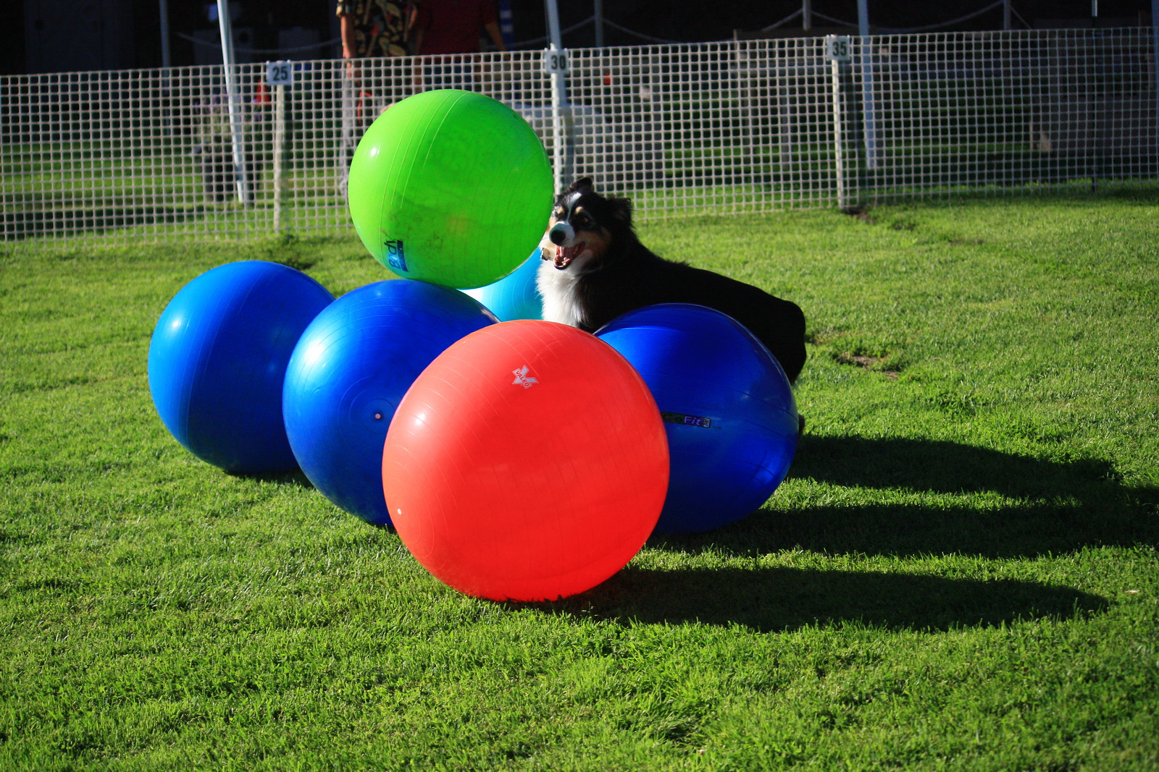
Distance is Key!
In Treibball distance work is KEY
Dog has freedom to choose
Train them to make decisions
REWARD YOUR DOG for choosing correct actions
Correcting an untrained dog in distance work is stressful & counter productive
The dog will vote with his feet & leave, sniff, etc.
Force can’t work
“You can’t put a choke chain on a dolphin.”

Slide 20
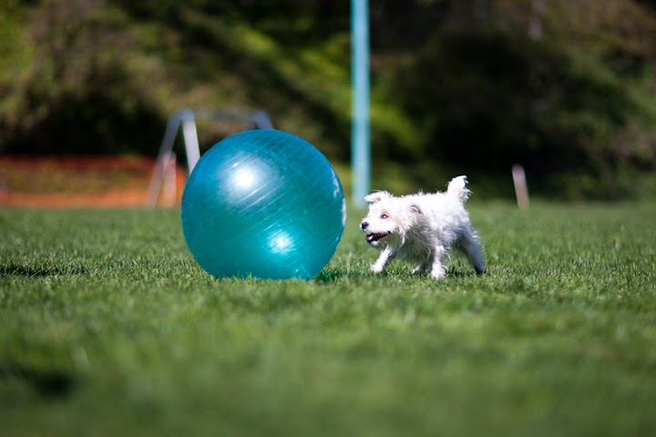
Shaping for Distance Work
Break behaviors down into the smallest parts
Rewards need to be delivered at a distance
Rewards: Be generous when changing criteria
Play as much as you train
Short, short, short sessions (30 sec. - 2 minutes)
Depends on the dog
Be patient

Slide 21
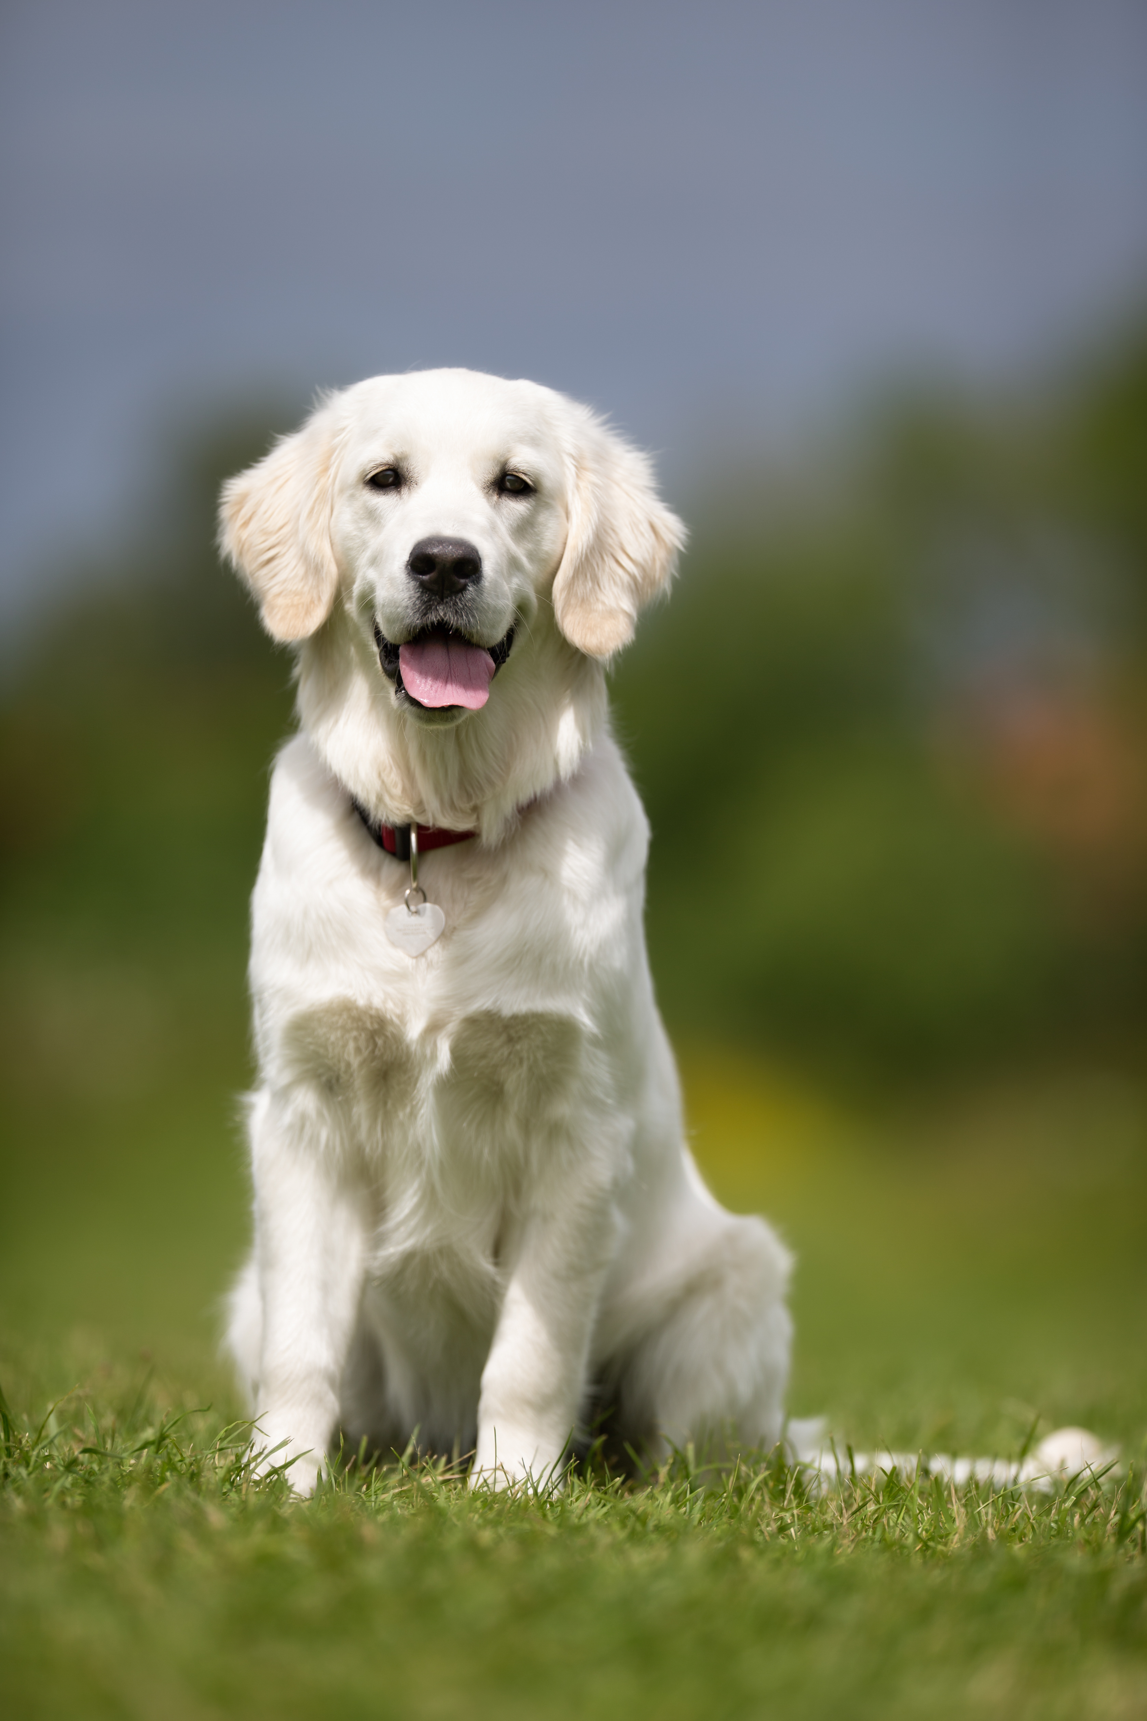
IC for Treibball
Obedience
Sit Until Released
Down Until Released
Distance Sit & Down Stay
Wait
Front
Leave It
Treibball
Heeling into the Ring
Ball Habituation
Wait Behind the Ball
Balancing
Dynamic position changes – balancing
Splat Down – Lily Pad Game

Slide 22
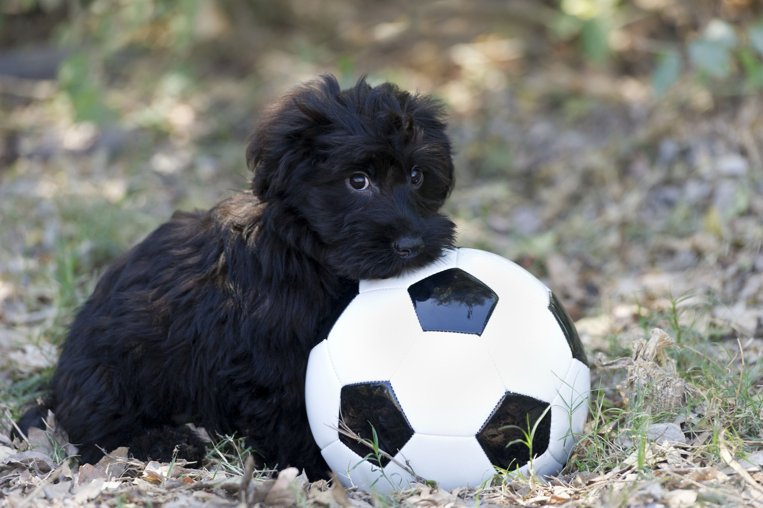
Can I Do Too Much IC Work?
It’s Possible!
Depends on the dog
Shy or fearful dogs may need motivation instead
Field breeds may need more
Rule: Pay Attention to the Dog

Slide 23
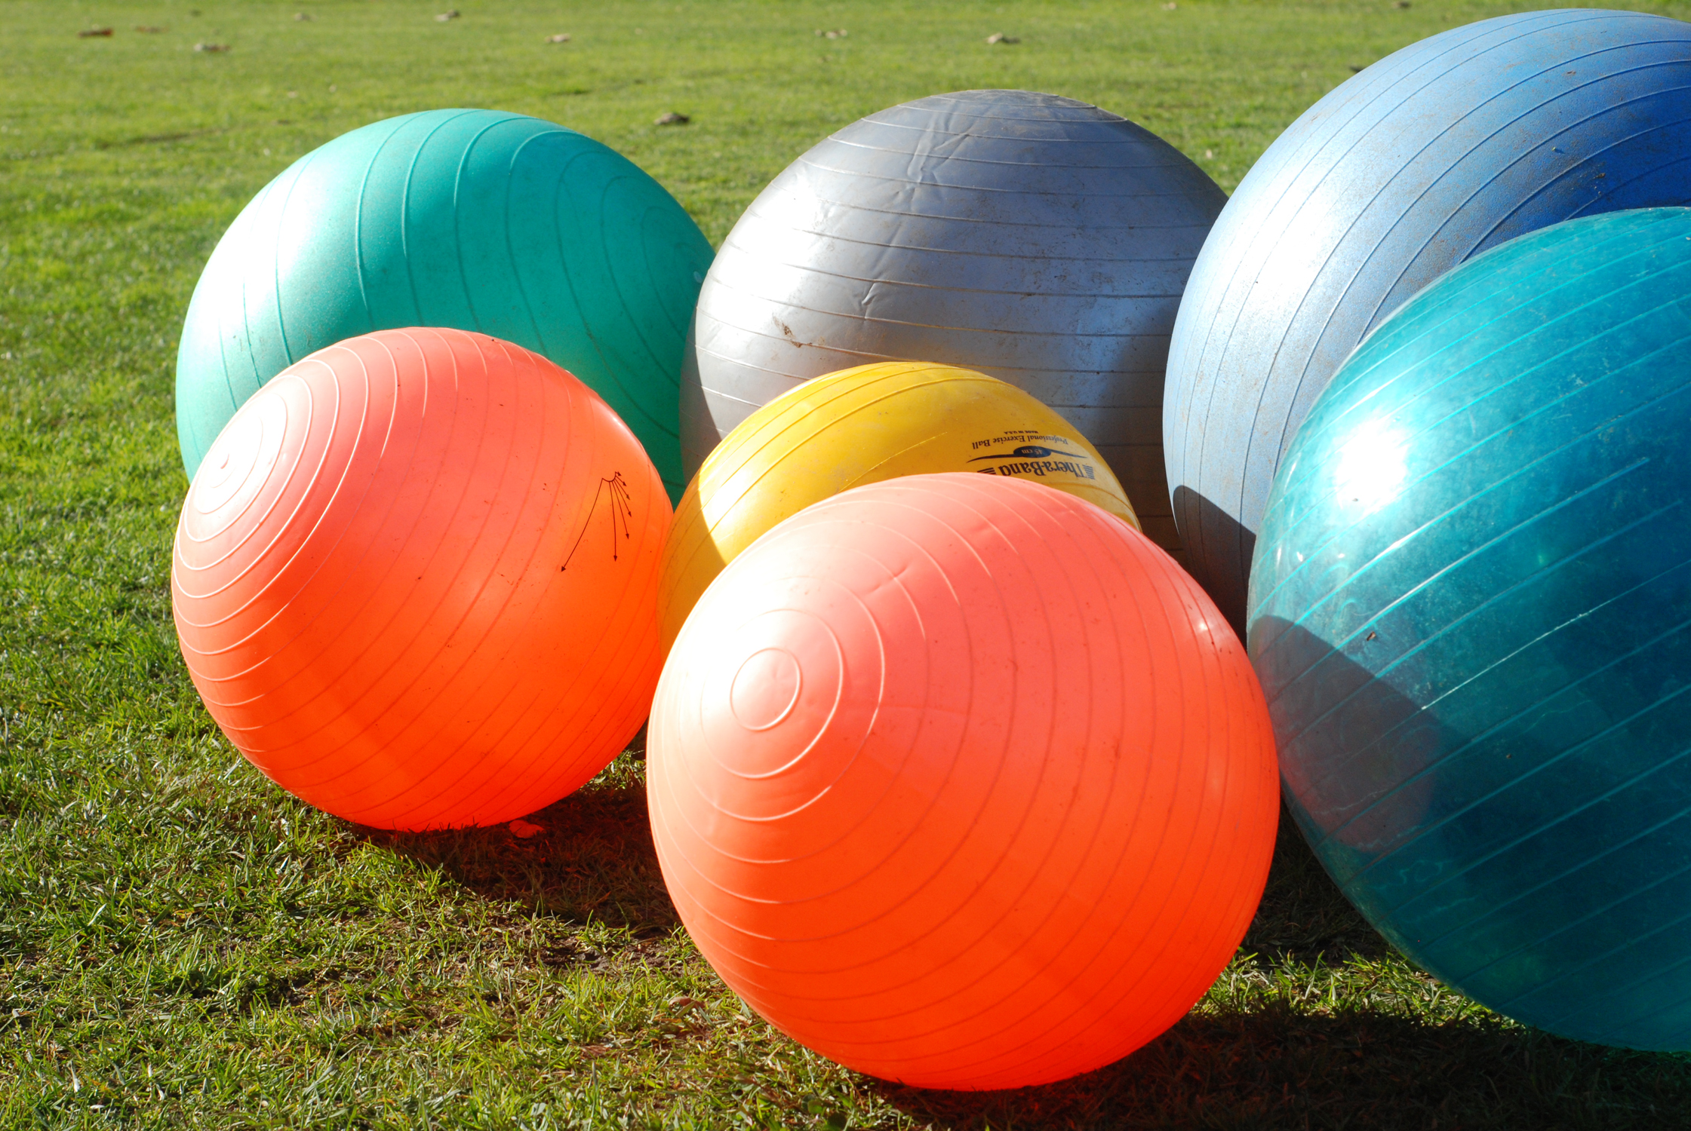
Ball Habituation & IC
Be the cookie! - You need to be more important than the balls
Make the ball a neutral stimulus before pushing
Have balls around training area - at a distance
Do obedience with balls nearby
Play games with balls next to you
Teach impulse control behaviors in other parts of life
Move the balls slowly with dog in a stay, then increase speed
Have your dog watch other dogs play, if they are calm
No teeth, feet or climbing on the ball

Slide 24
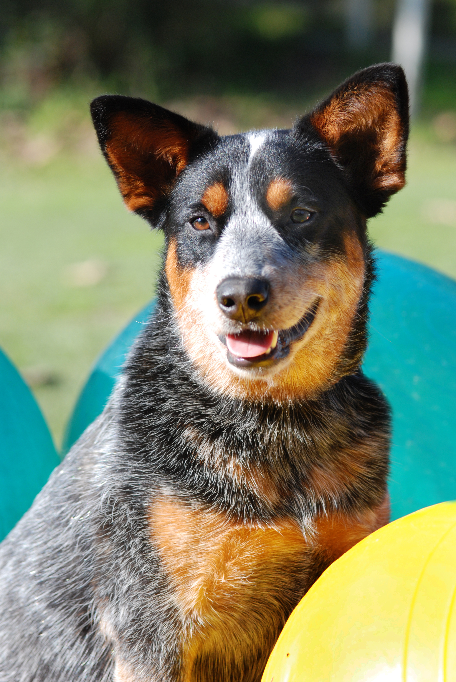
Introducing the Ball
SLLOOOOWLLYYY!
Don’t Rush into it with an over aroused or inhibited dog
Dial in your dog’s skills first
Balancing
Sit Behind an Object (other than a ball)
Flick Push
Distance Work
Introduce a ball without pushing
Then introduce the ball

Slide 25
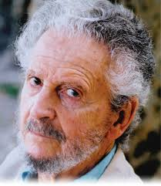
Use the Premack Principle
Less likely behavior is rewarded by more likely behavior
Define what your dog wants
Fetch, Running, Sniffing, etc.
Define what behavior you want
Pushing Balls
Set up the exercise
Have everything ready before you start
Train your dog
Dog pushes ball, then you play together
David Premack

Slide 26
Videos of Exercises for Treibball
Balancing Game
Warm up Game
Weave Ball Game
Ellie’s Heeling with Balls

Slide 27
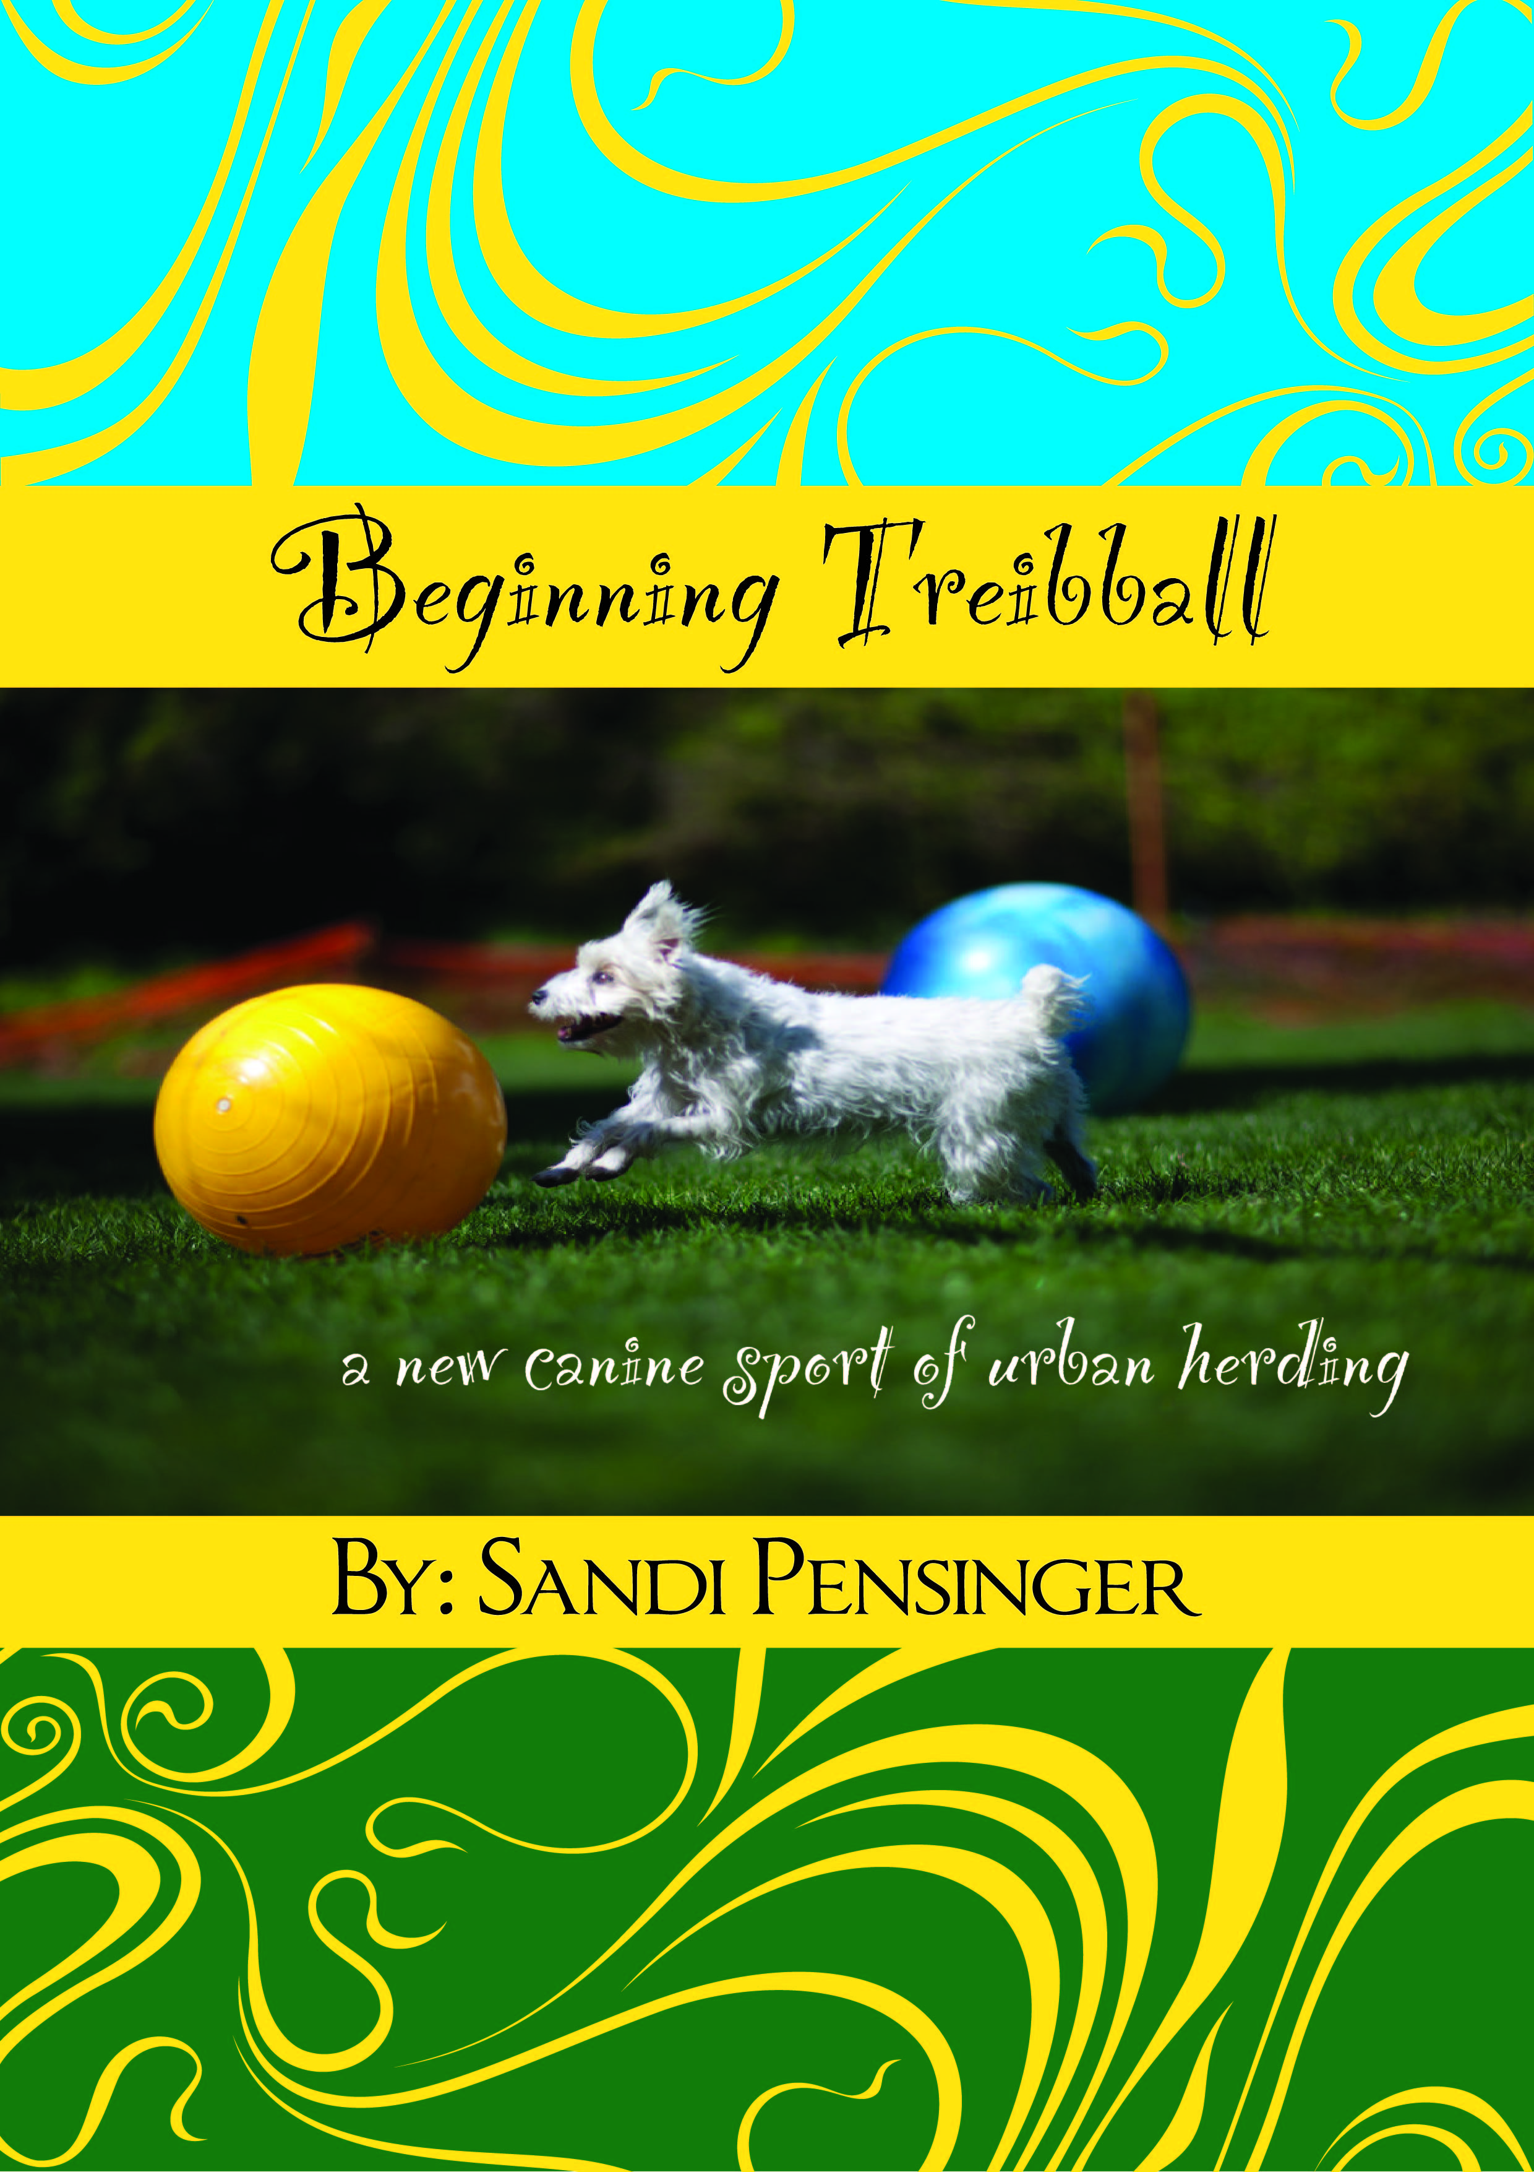
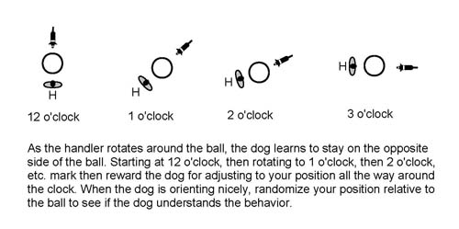
Resources
The Treibball Handbook
Treibball Videos (CEUs!)
Beginning Treibball (TawzerDog.com)
Intermediate Treibball (TawzerDog.com)
Online Coaching
www.livingwithdogs.us
www.nationaltreibball.com
NATE Members Facebook page

Slide 28
“Inch by Inch, Life’s a Cinch. Yard by Yard, Life is Hard”
Words to live by!

Slide 30
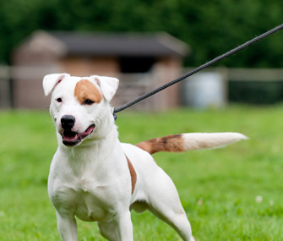
Discussion Points
What are your dog’s triggers?
Common triggers: food, toys, critters, people and dogs
How can you practice arousal to calmness?
Turn them on, then turn them off on cue
Where can you practice in new places/situations?
Avoid “But he can do this at home!” syndrome
How can you raise only one criteria at a time?
Avoid getting greedy for “faster” results
What exercises do you use to teach impulse control?

Slide 31
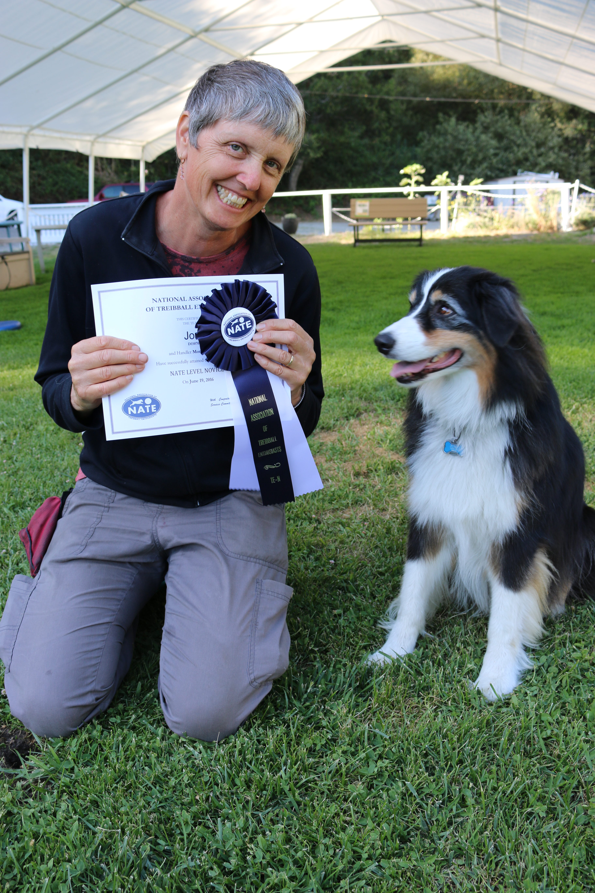
NATE Ribbons!
Event Hosts: you can order NATE specific ribbons
NATE logo is a stock image file at Hodges Badge Company
NATE Titling Ribbon for Virtual Competition
Want your ribbon?
Make your video.
Go to NATE website, Members Section, Competition Forms, Video Titling Submission

